Slide 1
ETL Tools on AWS
Sunitha Radhakrishnan
September 22, 2021

Slide 2
Objective
POC
To leverage ETL tools available in the Amazon cloud with help of employee migration data.
To evaluate and compare Glue and EMR (ETL AWS Technologies) costs and computational effort.
TechStack:
AWS Glue Studio, Cloud 9 Console.
AWS EMR - EC2
S3
PySpark
Git

Slide 3
Amazon Glue
About Glue
Serverless data integration service
Easy to discover, prepare and combine data for analytics, ML, and App Development.
Automatically scaling resources to cover the current needs of your situation.

Slide 4
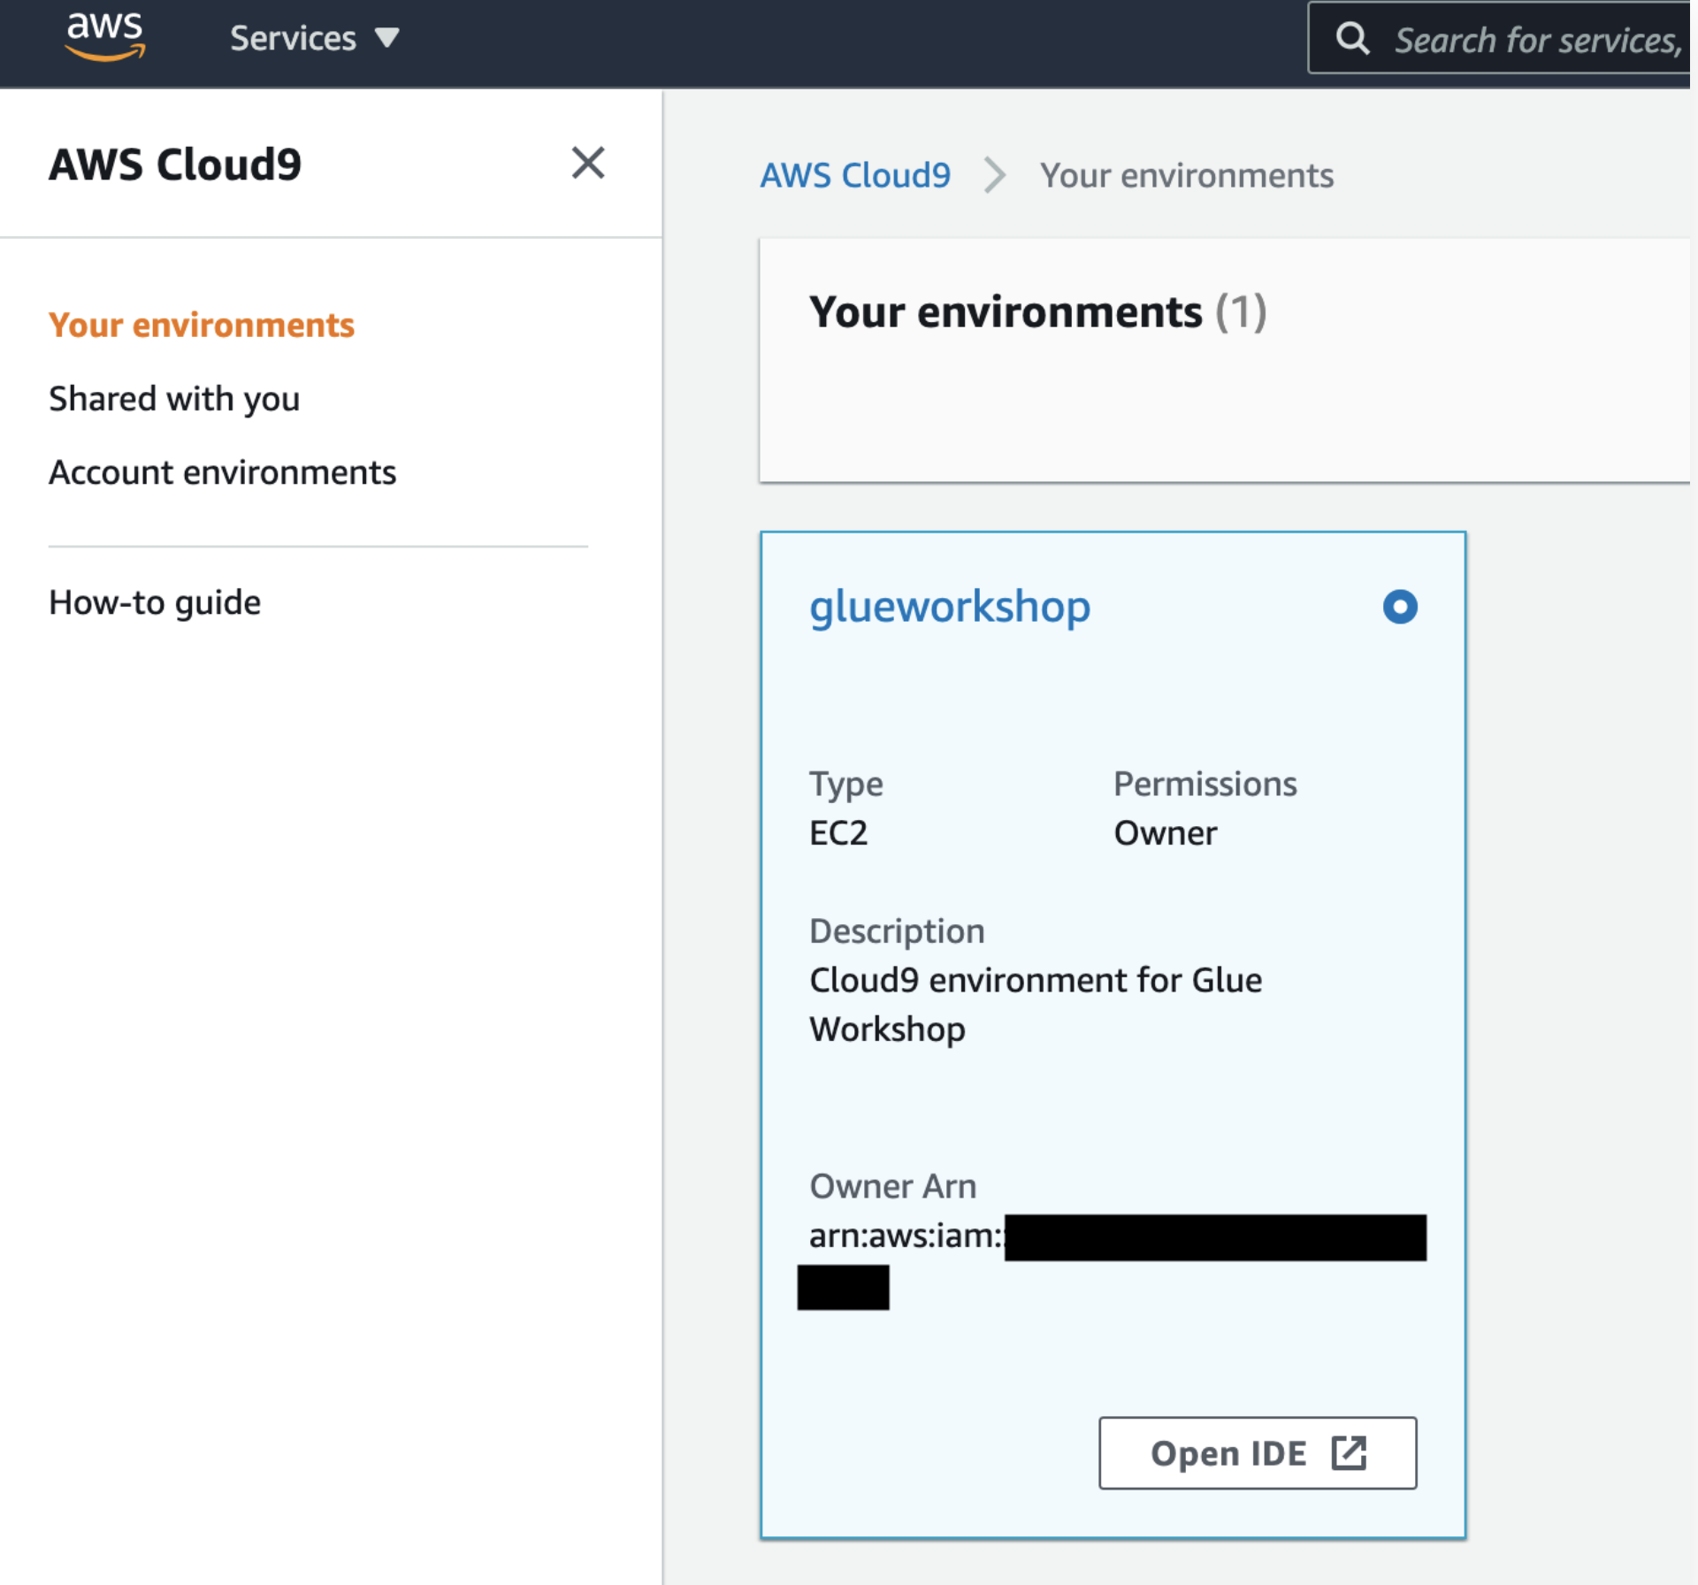
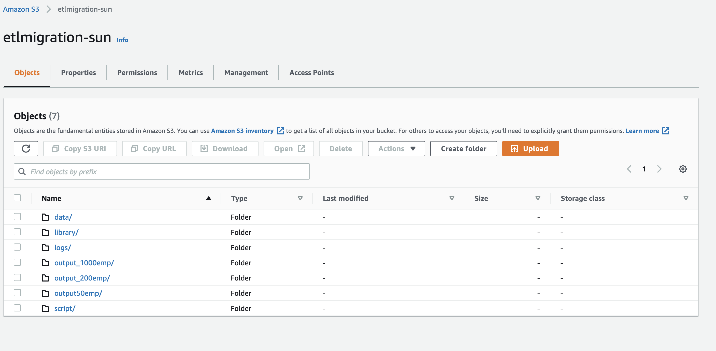
Steps
AWS Glue
Creating Cloud9 environment and get the files from Git.
Create S3 bucket inside cloud 9 IDE

Slide 5
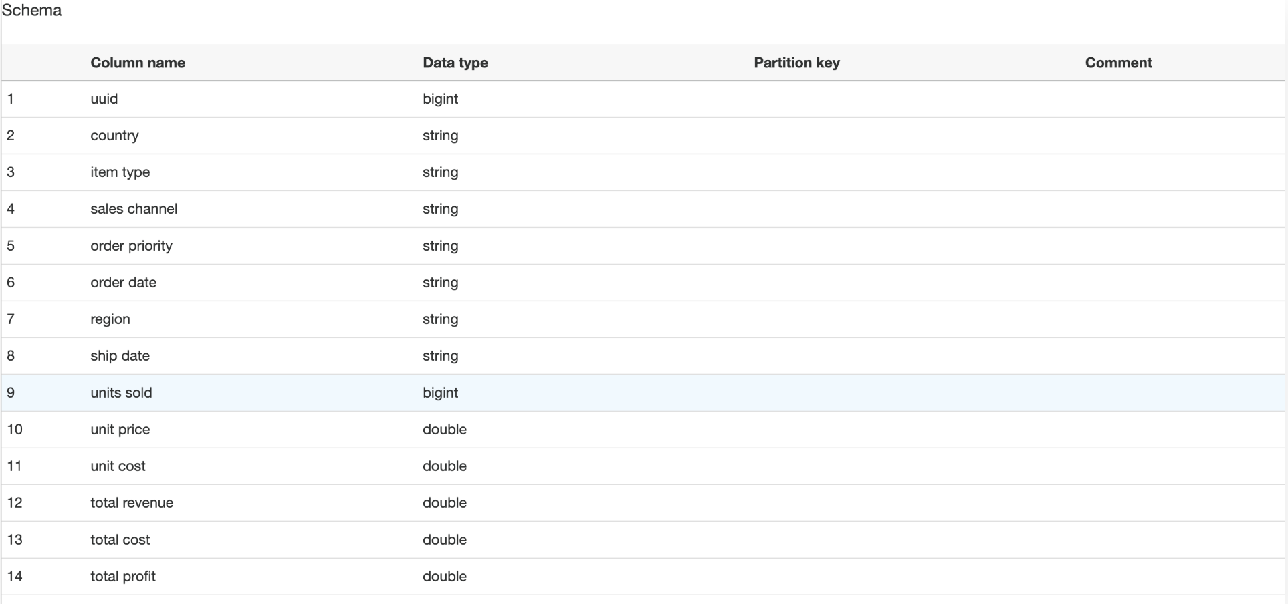
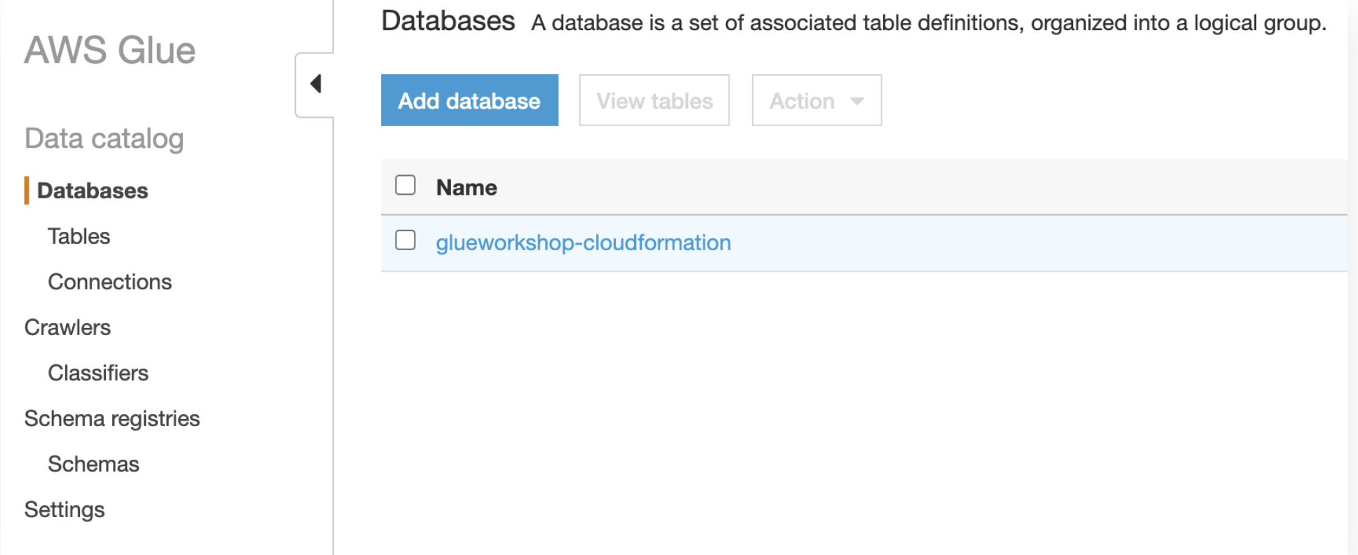
AWS Glue Steps
Create Data Crawler using Glue data catalog
Add database and crawlers to crawl the CSV
Run the crawlers

Slide 6
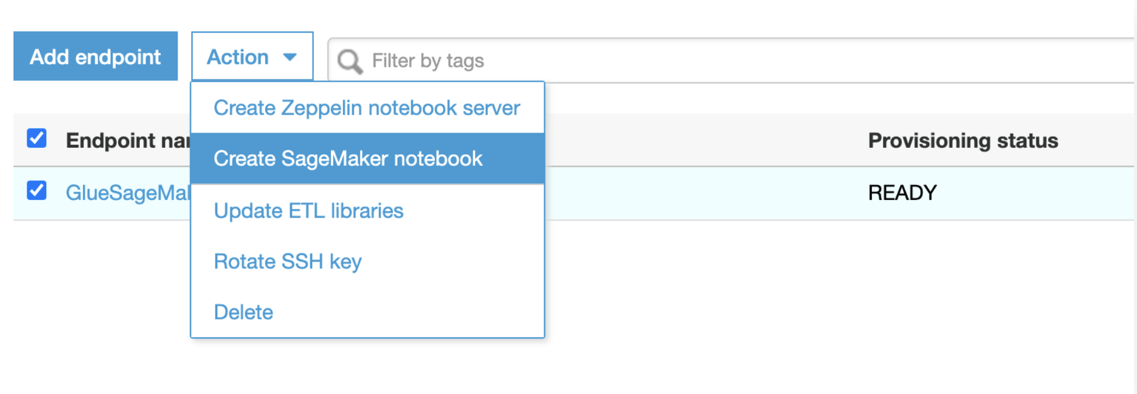
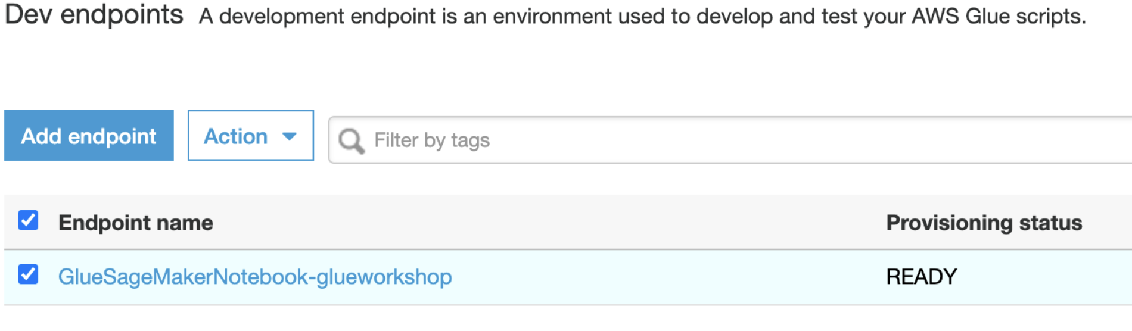
AWS Glue Steps
Creating AWS environment i.e Glue Dev Endpoint
Connect development notebooks like Sagemaker Notebooks
Deploy and Run the ETL Job.

Slide 7
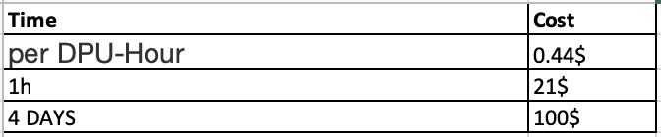
Observations
AWS Glue
Amazon Glue’s pay-as-you-go rate of $0.44 per DPU (One DPU=4 vCPU and 16 GB of memory)
The cost depends on the jobs run and dev-endpoint
Pros:
AWS Glue is capable of automatically generating ETL pipeline code.
Serverless architecture and job scheduling
Cons:
Only two languages - AWS Glue only supports Python and Scala
Limited Integration
Expensive when jobs has to run on daily basis

Slide 8
Amazon Elastic MapReduce (EMR)
About EMR
EMR is a big data platform designed to reduce the cost of processing and analyzing huge amounts of data.
A managed service where you configure your own cluster of EC2 instances.

Slide 9
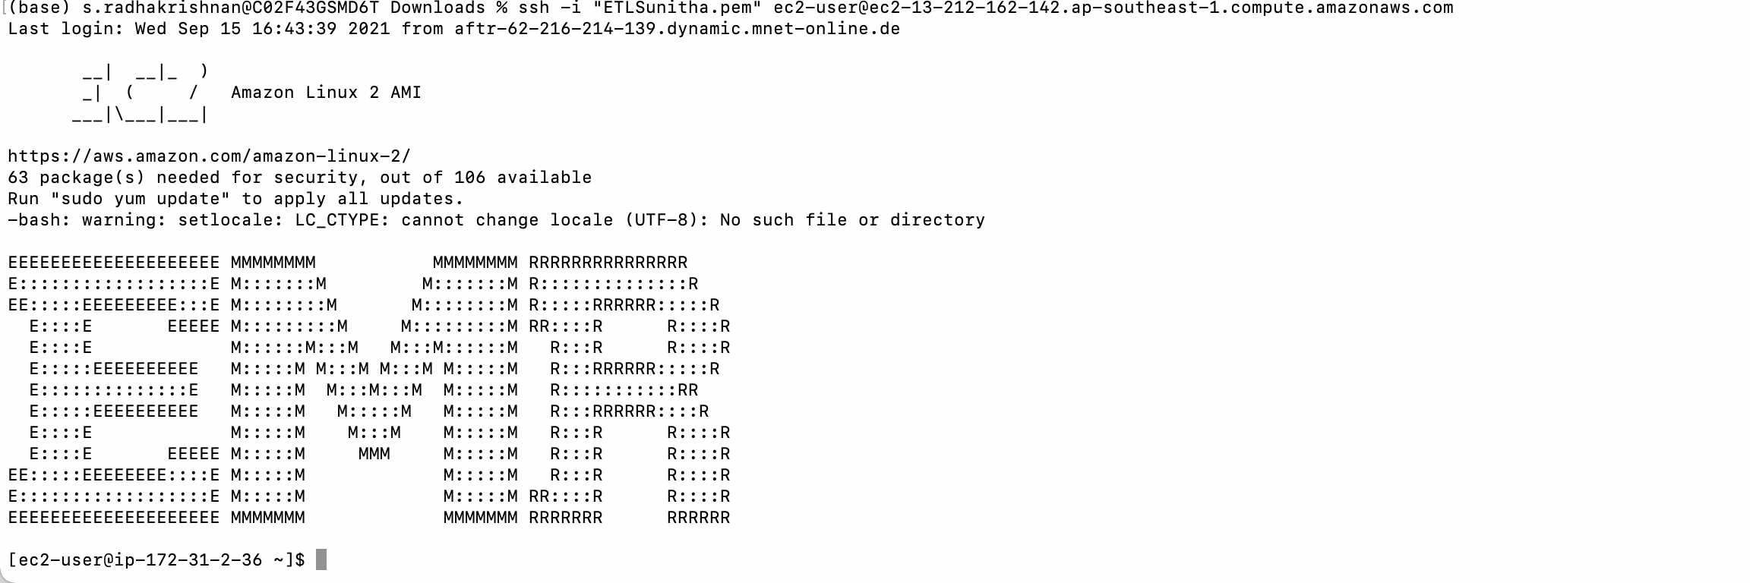
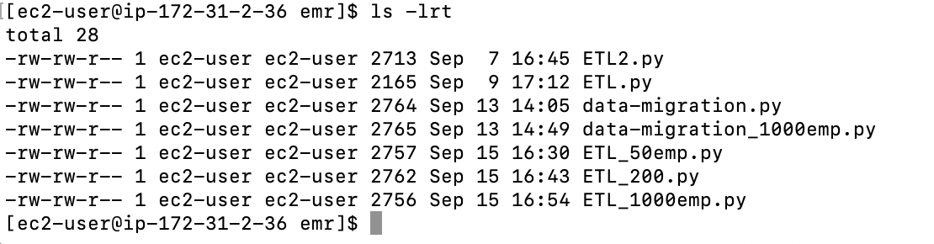
AWS EMR
Steps
Creating cluster using advanced options
Specify the software configuration and add step according to the application. In this case, it is Spark Application.
Choose the hardware and cluster settings
Check for EC2 security groups and generate EC2 Key pair
Once the cluster moves from waiting to Ready state, log in to the EMR Cluster

Slide 10
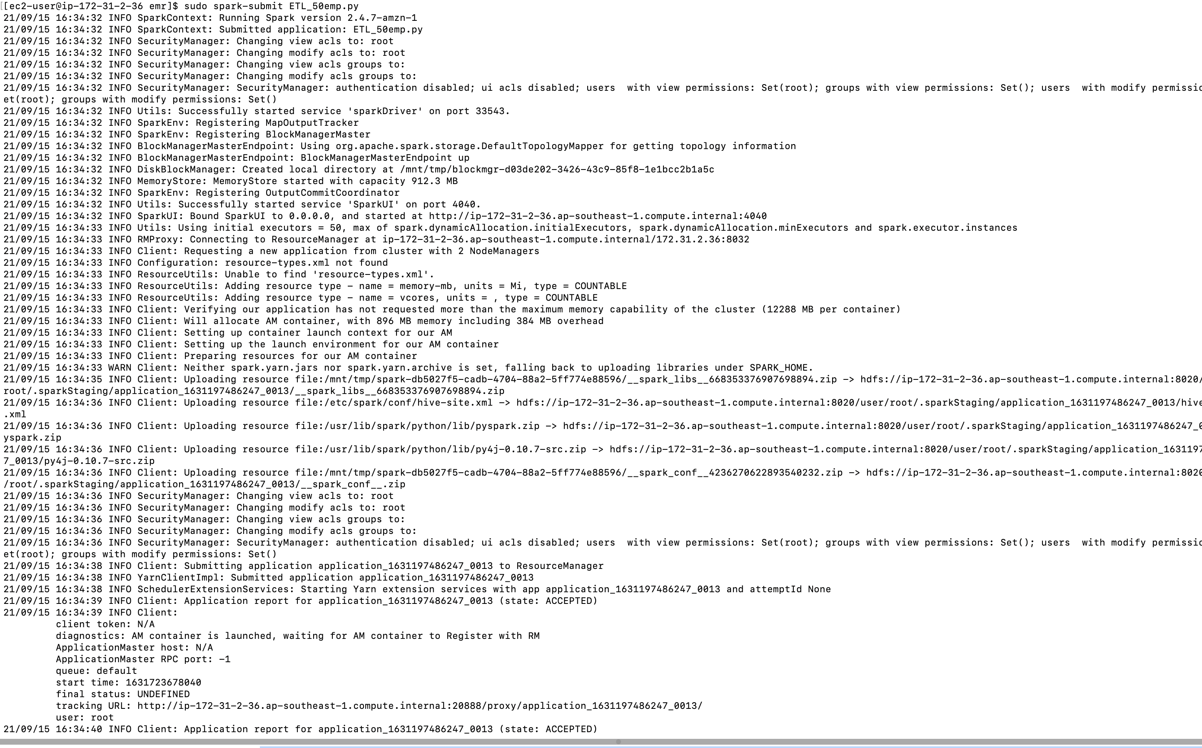
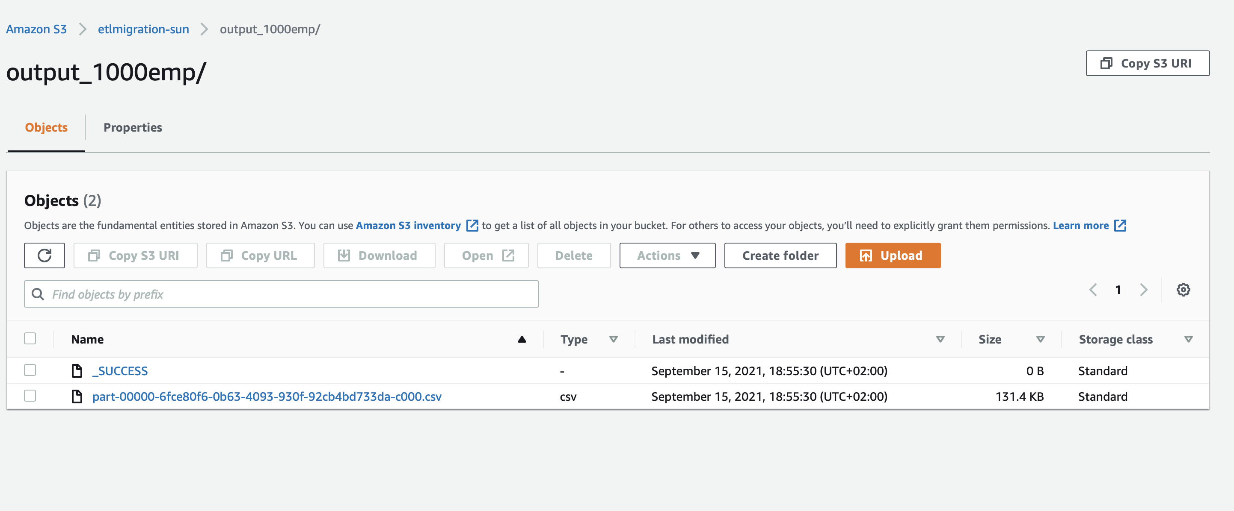
AWS EMR
Spark-Submit the python script using the spark application to run the application.
Output files generated and stored in S3 AWS.

Slide 11
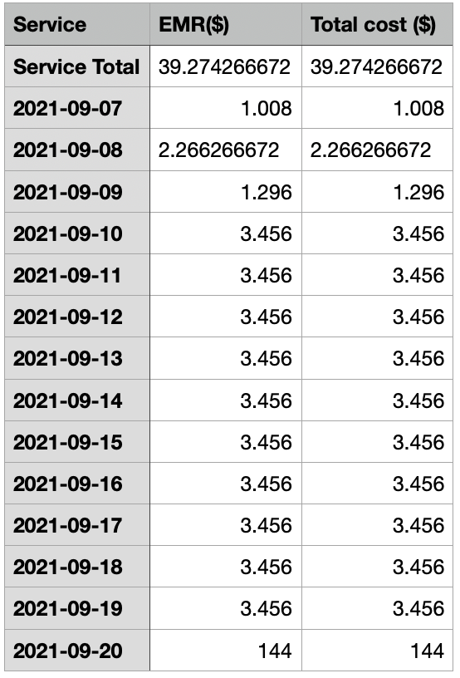
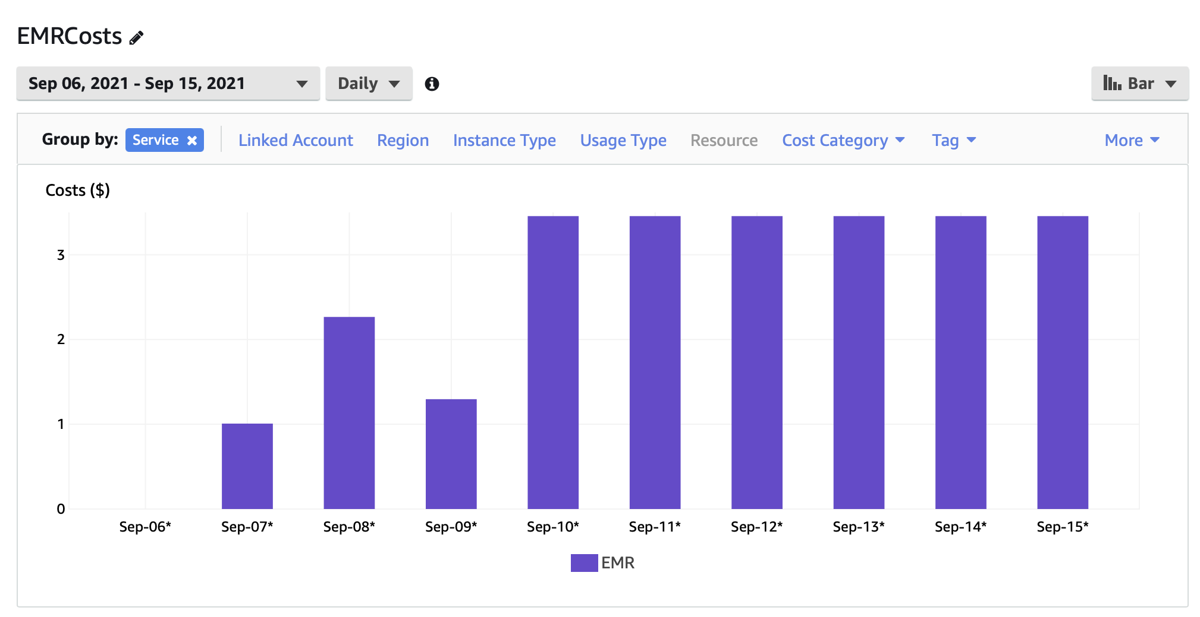
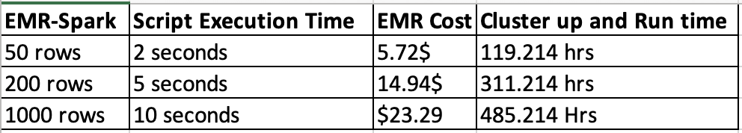
Observations
AWS EMR
Cost usage chart and benchmarking

Slide 12
AWS EMR
Pros:
Saves time in tasks like system administration.
In comparison with Glue, it saves a lot of costs for the company.
Cons:
Synchronization of metadata from S3 tends to become inconsistent sometimes.
Management overhead would not be as simple as Glue.
Alternate/Similar technologies:
Amazon Apache Airflow – for scheduling ETL jobs.
AWS Data Pipeline
AWS Batch
Future Scope:
Orchestrate Apache Spark applications using AWS Step functions and Apache Livy(REST API’s).
Emr - Apache Livy – Sagemaker.

Slide 13
Thank you!

